Slide 1
A History of Parallel Processing in Bioinformatics
By David Warshawsky

Slide 2
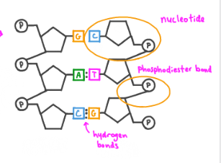
So what is Bioinformatics
Collection and Analysis of complex biological data.
Why do we need to know how data is collected?
2 types of DNA, RNA has multiple types, at least 7.
DNA’s double helix consists of two strands.
For the hardware explanation, you need to know about hydrogen bonds.
Note the difference between phosphodiester and hydrogen bonds.
H=Hydrogen = High Five.
P=Parallel. I’ll refer to H Bonds.
Notes:
Can’t leave the boring stuff to biologists. Chef making a dish without knowledge of ingredients freshness, taste, and how to prepare them. Can’t write code for a compiled programming language without specifying the data type, the compiler will not know how to represent the data.

Slide 3
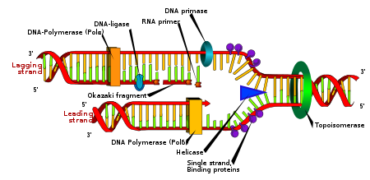
How is DNA replicated?
- Primers are like electricity in an electromagnet or a key to a lock. If you can’t find the key, you can’t open the door
- DNA Polymerase creates copies of DNA. Referred to as DNAP later.
- If something goes wrong, the DNAP stops building the corresponding new strand.

Slide 4
Next Generation Sequencing
- Different methods to sequence in parallel with high-throughput sequencing platforms
- Build off of Sanger Sequencing which was developed in 1977. Set many industry standards.
- Strand-ending nucleotides cause DNAP to stop building the strand.
- Missing a hydroxyl group. Prevents more P growth.
P = Parallel
H= High Five

Slide 5
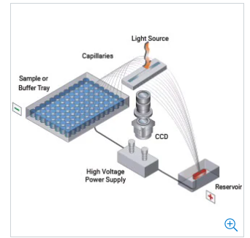
Capillary Electrophoresis
electric migration Parallelism
Longer DNA to be sequenced = Less accurate results.
High clock rate CPU controls temperature and power supply.
Silicon chip cameras in a macro-architecture pick up light with pixels that are turned into electrical signals.
CPU calculates the nucleotide based on light signal from fluorescent strand ending nucleotide(SEND).
Length of DNA sequence calculated based on time passing the camera.
The light peak analysis to determine the nucleotide on the camera is SIMD.
The start and end light pixels of a strand calculation to determine length is MIMD. Segmentation possibly for averages.

Slide 6
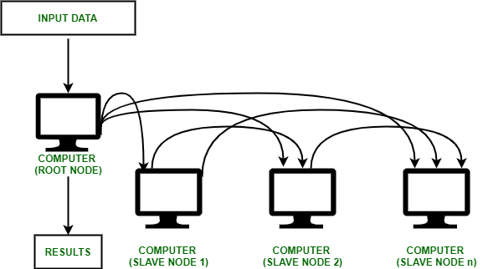
Cycle Sequencing
Small parts of DNA <100 nucleotides long
Can design
Primers are needed to connect to the beginning of identified sequences but not connect to other parts of the genome and so cluster computing can be taken advantage of to design them.
Economic concerns and small scale nature of it don’t require cloud computing but a more localized university cluster is sufficient.
OpenMP shared-memory architectures
MPI, Message Passing Interface
GPU acceleration

Slide 7
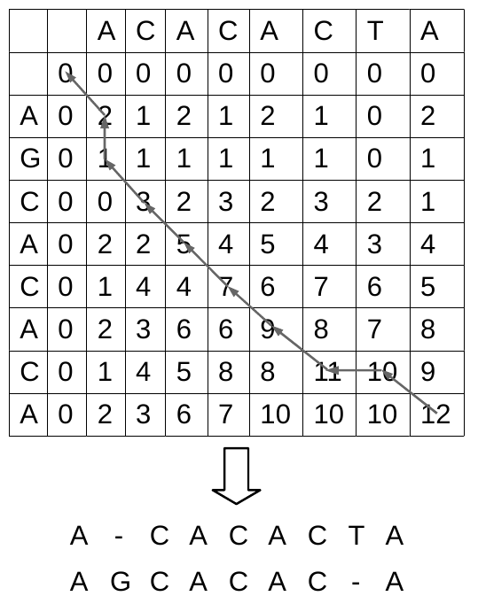
Parallel Processing in Software
Quality filtering of nucleotides
Divide and Conquer heavily used.
SIMD for alignment algorithms splits up sequences to align in many threads across nodes whether CPUs, GPUs, or other calculation devices.
Smith-Waterman Alignment Algorithm local alignment parallelization.

Slide 8
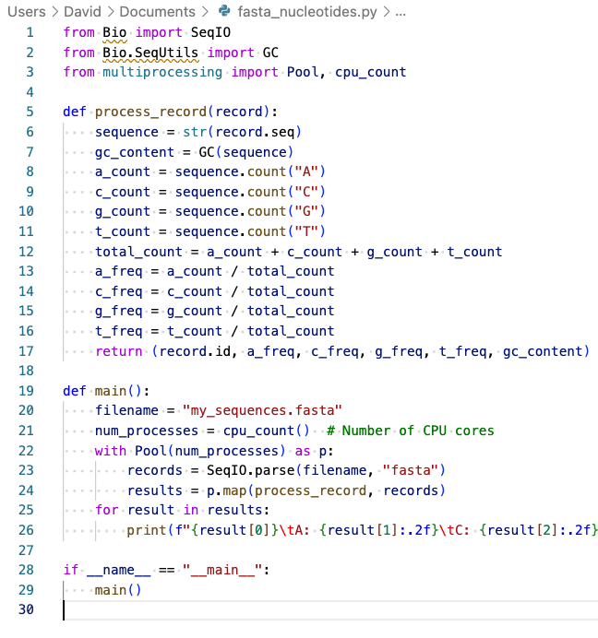
Coding Example

Slide 9
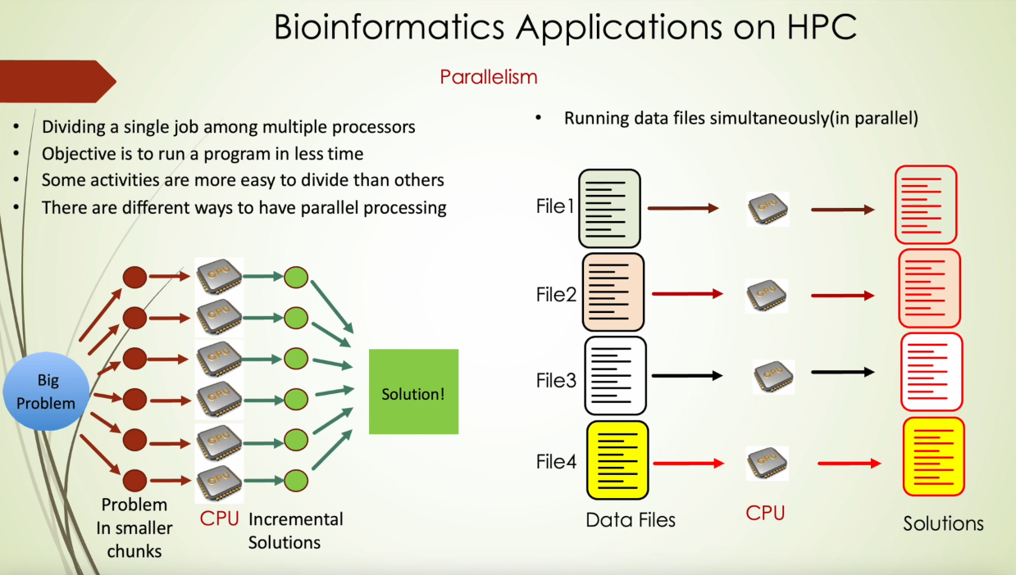

Slide 10
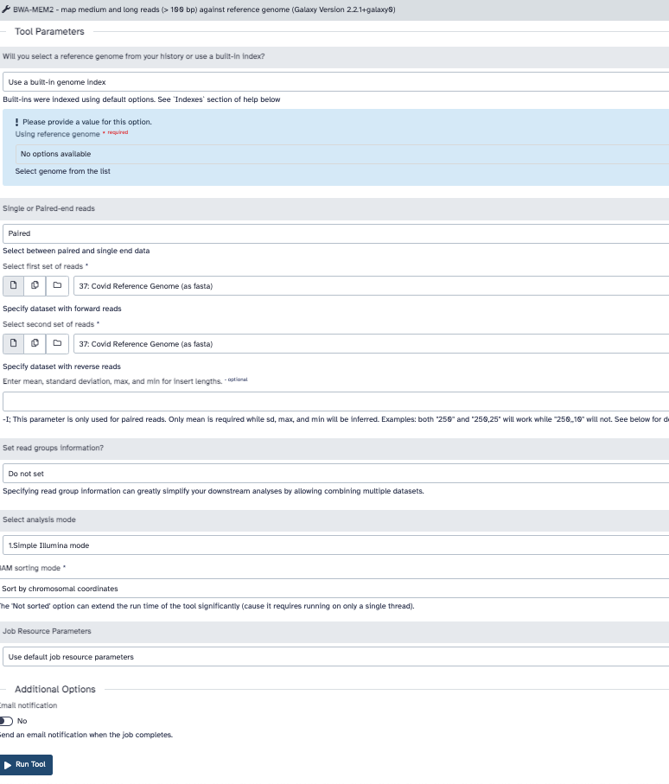
HPC Distributed Tools

Slide 11
References
Agilent Technologies. (n.d.). Femto Pulse 12-Capillary Array [Online image]. Retrieved from https://www.agilent.com/cs/publishingimages/12-capillary-array-zoomtb-320x320-agilent.jpg. [Accessed: Apr. 23, 2023].
Computational Biology Core, University of Connecticut. (2023, April 7). 04_HPC in Bioinformatics: How does it help? [Video]. YouTube. https://www.youtube.com/watch?v=dV6mM-GJeII&ab_channel=ComputationalBiologyCoreUConn
Galaxy Team. (2018). Galaxy: A Comprehensive Approach for Supporting Accessible, Reproducible, and Transparent Computational Research in the Life Sciences. Communications of the ACM, 61(8), 48-54. doi: https://doi.org/10.1145/3233027
Gauthier, J., Vincent, A.T., Charette, S.J., & Derome, N. (2018). A brief history of bioinformatics. Briefings in Bioinformatics, 21(6), 1-9. doi: 10.1093/bib/bby063. PMID: 30084940.
Liao, W. K. (n.d.). Parallel K-Means Data Clustering. Retrieved from http://users.eecs.northwestern.edu/~wkliao/Kmeans/
Lee, W. (n.d.). BIOL CS 123B: Bioinformatics II [website]. San Jose State University. Retrieved April 22, 2023, from https://sites.google.com/sjsu.edu/biolcs123b-sjsu/home?authuser=1.
Nagwa. (n.d.). Question Video: Recalling the Type of Bond That Forms between Adjacent Nucleotides in the DNA Backbone. Nagwa. https://www.nagwa.com/en/videos/757134320416/
Promega Corporation. (2019). What Is Capillary Electrophoresis? [Video]. Retrieved from https://www.youtube.com/watch?v=x7PUqNA0eOA&ab_channel=PromegaCorporation
Thermo Fisher Scientific. (n.d.). Sequencing Reaction for Sanger Sequencing. Retrieved April 22, 2023, from https://www.thermofisher.com/us/en/home/life-science/sequencing/sanger-sequencing/sanger-dna-sequencing/sequencing-reaction-sanger-sequencing.html
Wesley, L. (2022). CS 123A Bioinformatics I. San José State University. Fall 2022. Based on code from the author's previous project.

